Slide 1
Ways We Use Fractions
Where do you use fractions?
Welcome, while you’re waiting please share your experiences about where you use fractions outside instruction on the 11 X 17 sheet provided at your tables.
Notes:
<<Note to Presenter: text enclosed by << >> are notes for the presenter and not part of the script>>
<<place one 11X17 sheet on each table>>
Please take a few minutes to record where you use fractions outside classroom instruction. Share more than one example. <<Monitor and provide prompts when needed: think about where you use them in the workplace, at home, out shopping, building/ craft projects, travelling., etc. Select a few interesting examples with the whole group on slide 3: Session Goals>>

Slide 2
Ways We Use Fractions Math for Teaching
Five Constructs to Think about Fractions
Notes:
Welcome to today’s session on Ways We Use Fractions. I am ___________.

Slide 3
Learning Focus
Participants will:
explore the multiple constructs used to think about fractions
understand how context changes the way we think about a fraction
recognize the benefits of teaching various constructs simultaneously
Notes:
Our session today is based upon many years of research, including the recent research within Ontario lead by Dr. Cathy Bruce in partnership with the Curriculum and Assessment Policy Branch of the Ministry of Education. The research has highlighted some critical fractions learning which we will explore further today. In particular, you will: ( Bullet 1) The research has revealed interesting differences between the ways that fractions are understood within North American culture and other cultures. We will explore the numerous ways that we use fractions and then we will revisit the variety of contexts that were discussed in the focussed chat at your table. <<Don’t talk about what the constructs (meanings) are or any issues around representations yet.>>
(Bullet 2) We measure with them and we bake with them and perhaps share some good examples that you noticed from the table sharing. Sometimes a context is helpful and sometimes a context can limit the flexibility of thinking. We will look at how we are more likely to attribute one fraction construct to a context even though others are just as applicable.
(Bullet 3) In North America, we tend to separate the fraction constructs in our instruction rather than teach the interconnectedness of these notions. As we become aware of how we are culturally influenced in our teaching of fractions, we are better able to make purposeful decisions which support better student understanding.

Slide 4
Session Norms
Be engaged in the tasks and discussions as this enriches everyone’s experience.
Be a learner – it is fun!
Actively seek connections between the research and your classroom experience.
By better understanding student thinking we better understand the impact we can have on their learning.
Notes:
These are the norms for today’s session.

Slide 5
Agenda
 | Intended Audience
Where Do You Use Fractions? | Student
Sticky Note Fractions | Educator
Overview of Five Constructs
Deeper Look at Part-Whole and Part-Part
A Look at Student Work
Fractions Shape Sets | Student
Resources
Notes:
This is what we will be doing in this session. Notice that we have identified the intended audience for the tasks. The tasks designated as Educator are not intended to be used with students.

Slide 6
Sticky Note Fractions
Think of a fraction
Now represent your fraction in as many different ways as you can
Write each representation on a sticky note
– one representation per note
Notes:
I would like you to think of a fraction and then write representations for that fraction on sticky notes (a few minutes). Please ensure that each representation is on a different sticky note.
<<about 25 minutes for slides 6 and 7>>

Slide 7
Sticky Note Fractions (cont’d)
There are six charts posted around the room:
Number/linear measure
Part-whole
Part-part (ratio)
Quotient (numerator divided by denominator)
Operator (enlarging or shrinking)
? (not sure)
Place each of your representations on an appropriate chart
Notes:
<<Chart headings>>
We have placed six charts around the room with the following titles: number/linear measure, part-whole, part-part, quotient, operator and unsure. Sort your representations by the types of fractions in the list. Place your sticky notes on the appropriate chart. We are going to discuss and sort again later so make your best guess if you are uncertain. Once all the sticky notes have been placed, walk around the room to look at the charts before returning to your seat.

Slide 8
Sticky Note Fractions Trends
Using a show of hands answer the following question.
How many of you used …
proper fractions
improper fractions
mixed fractions
benchmark fractions
unit fractions
Notes:
Ask participants: What kind of fraction did you use?
<<Name the types one at a time and record the trend use for each type (a lot, some, a few, hardly any). In summary, you will likely notice an overuse of proper fractions which you should point out to participants we will speak more about this later. If this does not turn out to be the case you can tell participants that many of them have used a type of fraction that is underused in North America.>>

Slide 9
Sticky Note Fractions Trends (cont’d)
Using a show of hands answer the following question.
What representations did you use?
circle
rectangle
set
number line
volume
symbolic
anecdotal
Notes:
Ask participants: What representations did you use?
<<Name the types one at a time and record the trend use for each type as indicated (a lot, some, a few, hardly any) They need to raise their hands for every type they used. In summary, you will likely notice a significant use of circles especially in the elementary panel, and little use of volumes and number lines. If this does not turn out to be the case you can tell participants once again that volume and number lines are generally underused in North America, but this group has used these representations in higher numbers than expected.>>

Slide 10
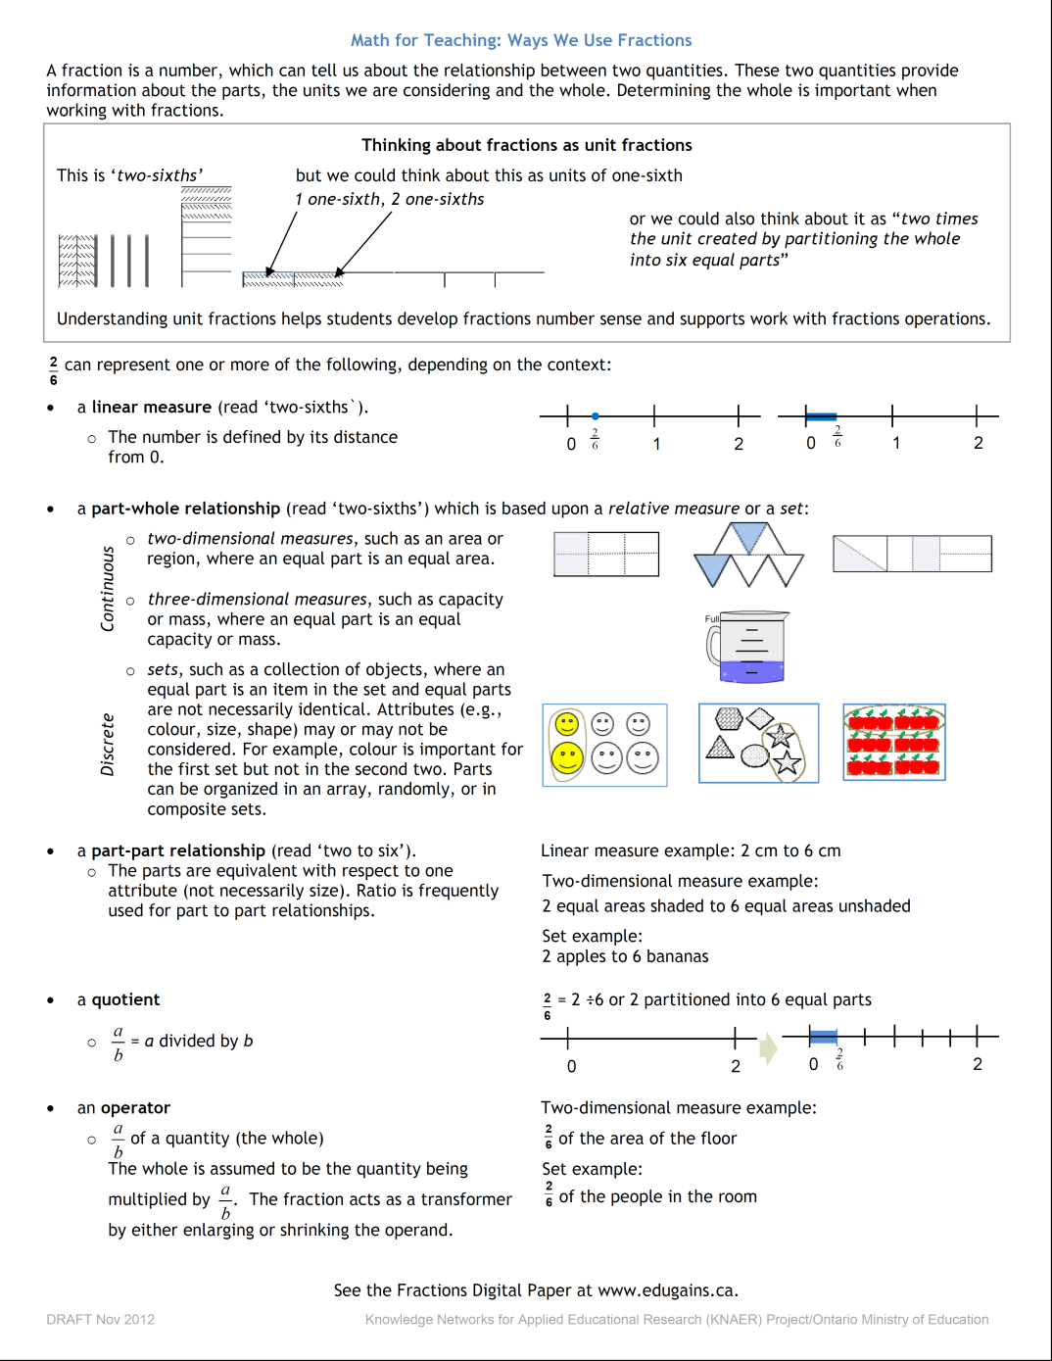
Math For Teaching: Ways We Use Fractions
Notes:
Keep the representations in your mind as we discuss the ways we use fractions.
<<Distribute the Ways We Use Fractions one pager handout.>>
This is the one page summary that you now have in front of you. As we move through the constructs (meanings) you can reference both this and your own representations. Feel free to make notes right on the page so you can refer to them later.
This one pager can be found on EduGAINS www.edugains.ca – Mathematics – Lessons and Supports – Additional Fractions Supports.

Slide 11
Multiple Constructs (Meanings) of Fractions
Part-whole relationship
Part-part relationship (ratio)
Number/Linear measure (distance from 0)
Fraction as operator (multiplicative action on quantity)
Fraction as quotient (division relationship)
A fraction is one quantity or amount
Notes:
<<There is a lot of critical information in the notes for this slide, it might be overwhelming for participants but assure them that the points will be revisited many times during this workshop>>
When instructing fractions most of our focus and certainly our starting point has over the years been with the part-whole relationship, using either discrete representations (such as a set) or continuous representations (such as a number line or area models like rectangles and circles). Students in North America spend much of their fractions learning focused on part-whole fractions.
However, it is clear there are multiple constructs of fractions <<click through the rest of the fractions to quotient>> and research in this area encourages working toward a deeper understanding of the multiple constructs to support student learning beyond fractions.
As well, when teachers hold a deeper understanding of these constructs they are able and inclined to naturally enhance their instruction, more often drawing student attention to the various applications across the constructs. This in turn will develop in the students a deeper understanding. (E.g., when instructing about the role of the digits of a fraction, in particular the denominator, a teacher with a deeper understanding of the various constructs may take time to bring the student’s attention to the truth that the denominator tells you the number of equal sized pieces the whole has been cut into for a part-whole fraction but not for a part-part fraction; the teacher may refine their thinking of multiplication beyond ‘multiplying two numbers always results in a larger number’ as this is true for whole numbers but not always true for fractions or decimals or integers).
So we can agree that a deeper understanding of the multiple constructs of fractions is important to support students in learning beyond fractions, This learning includes:
Writing slope expressions in grade nine and beyond, which are part-part relationships
Understanding fraction as an operator (enlarging/shrinking action) (multiplying fractions less than one is a shrinking action where dividing fractions less than one is an enlarging action) this understanding extends into functional thinking in secondary school and also connects to decimal number operations
Distinguishing between when to apply the rules for operations with part-whole fractions and the rules for part-part fractions. For example, when adding part-whole fractions as numbers, a common fractional unit is essential but when adding part-part fractions as in ratios, the numerators are added together and the denominators are added together. Teachers do this always when marking test…we will take a closer look at that example later but another example might be (e.g., if we had a 2/5th as many girls as boys in one group, meaning for every 2 girls there were 5 boys, a ratio of 2 to 5 and in a second group we had 3/4th as many girls as boys, meaning for every 3 girls there were 4 boys, a ratio of 3 to 4 and we put the two groups together we could say in the new group we have 5/9th as many girls as boys, meaning we had 5 girls to each 9 boys or a ration of 5 to 9. )
So let’s take some time to look at each of the constructs in a bit more detail. …recall your representations used earlier…it may be helpful to refer to them and as we move along, reflect on what you chose, how you represented it and maybe what you were thinking.
For more information, see the Literature Review Foundations to Teaching and Learning Fractions: Addition and Subtraction and Paying Attention to Fractions.

Slide 12
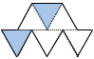
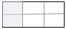
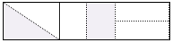
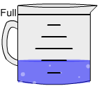
Part-Whole Relationships: Continuous Model
Linear models
0
1
2
2D Area Models
3D Models
volume
surface area
Notes:
The part-whole relationship is one we tend to be most comfortable with in North America. These are continuous representations of part-whole relationships. The size of the regions must be the same. Note that in the rectangle to the right in blue, each piece is one-sixth but they aren’t the same shape, merely the same size. (If you are having difficulty seeing this, first look at how the rectangle is dividing into thirds, then each third is divided in half so each small section is half of a third or one-sixth. )
These representations are continuous because they are measured. You may wish to think about how they are connected or continuous from one region to another.

Slide 13
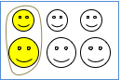
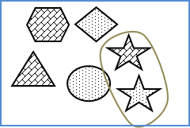
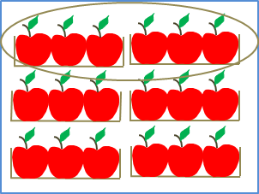
Part-Whole Relationships: Set/Discrete Models
Notes:
These are set, or discrete representations. It is important to note that in a set not all the items need to be the same shape. With sets, any attribute can be used. Think of describing a group of people – they are not the same size but you can use a fraction to describe the group because you choose one attribute to use, such as hair colour, number of years teaching, wears glasses, etc.
These representations are discrete because they are counted. You can think about how each set contains discrete items.

Slide 14
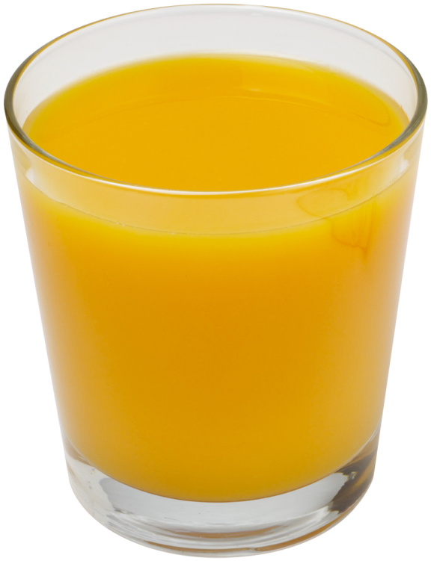
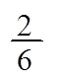
Part-Part Relationships
2 parts orange concentrate to 6 parts water
2:6
There is as much orange concentrate as water in this glass
The slope of a line is
The tangent of angle A is
2
A
6
Notes:
We also use fractions to describe part-part relationships. Mathematical concepts, such as slope (Gr 9) and trigonometry (Grades 10-12) rely on understanding of fractions as representing part-part relationships.
Note that we could use both of the previous models (area and set) to discuss and represent part-part relationships, although we frequently think of it within a volume context (oil-gas) or a triangle (rise-run; trigonometric ratios).
Fractions are often used to describe part-part relationships but we are often not explicit about how this fraction is different from part-whole fractions.
Looking at the glass of Orange juice we know it is made of concentrate and water. If our understanding is based on the part-part construct what does this fraction tell us how much water and how much concentrate? There is 2/6th as much orange concentrate as water in the glass.
In mathematics classrooms, we see junior students using fractions to communicate part-part relationships. In intermediate classrooms, students may solve proportions using an algorithm which includes writing ratios as fractions. In secondary mathematics, representations of slope and trigonometric ratios are both examples of where part-part relationships are written in fraction form.
<<This illustrates 3 important instructional considerations. (Try to make sure it is addressed in the conversation of the participants. )
The importance of explicitly defining the whole (bringing attention to what is being referenced as the whole).
The importance of uncovering the thinking of the students.
Surfacing two conflicting mathematical notions that can both be correct given different contexts…work to build awareness about it. This reinforces divergent thinking around math. >>
Our instincts may lead us to believe that if we teach each construct separately they become clearer in the student’s mind and we avoid confusion. But the reality is students hold both constructs in their heads – sometimes with conflicting notions. We do have a slide of students’ work coming up that will illustrate this point.

Slide 15
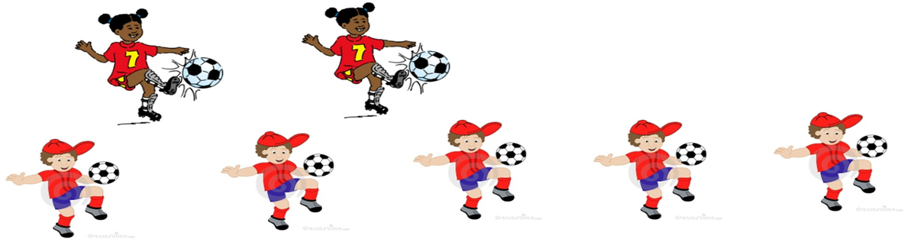
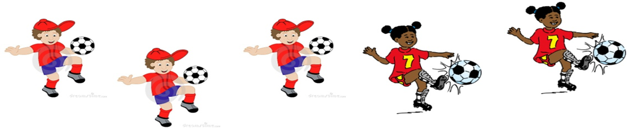
Part-Part Relationship
Part-Part Relationship
as many girls as boys……2 girls and 5 boys for a team of 7 players
Part-Whole Relationship
girls
players in total
Part-Whole Relationship
of the people on the team are girls…. 2 girls and 3 boys for a team of 5 players
Part-Part Relationship
girls
boys
Notes:
We can describe any relationship using a variety of fractions. Let’s compare the use of part-part and part-whole relationships to describe soccer teams. The inclusion of some annotation, such as that modeled here, allows clearer communication of the relationship being communicated. <<Review the various fractions represented by each picture. This illustrates the importance of context, since both fractions are correct depending on the context used.>>
Would some of your representations in the sticky note activity benefit from annotation? You will have a chance to annotate later.

Slide 16
Linear Measure
0
1
2
0
1
2
Notes:
In North America, little emphasis is placed on seeing number as a linear measure, or distance from 0. Notice that the arrow clearly shows distance from zero, while the dot shows a position relative to zero. This is a foundational understanding in Asian instruction and appears to provide significant support to students as they move from modeling a fraction to calculating with fractions. The number line also allows students to connect to their whole number sense and extends easily into other number systems, such as decimals and integers. Understanding of the number line supports students in subsequent activities related to graphing and scaling axes.

Slide 17
Fraction as Operator
of a quantity
of the distance to school
Home
School
Notes:
Fractions as Operator enlarge a quantity if the fraction is greater than a whole or diminish/shrink the quantity if it is less than a whole.
For example, ½ of a quantity (like the square footage of a room) will diminish the quantity but if the fraction is over a whole, such as 3/2, it enlarges the quantity. We often think that since the ‘of’ means ‘multiply’ that it is an intermediate concept. However, as early as Kindergarten, students are asked to identify ‘half of the cookie’ or ‘half of the water in the jug’ or ‘half of the class’. These are early exposures to fractions as operator, and continue consistently through to the introduction of formal algorithms in intermediate grades.

Slide 18
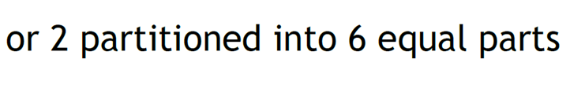
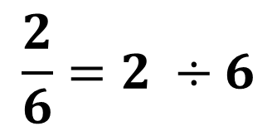
Fraction as Quotient
$$\frac{2}{6}=2 ÷6$$
0
1
2
Consider two granola bars….
Notes:
Like the operator construct, the quotient construct is also considered to apply to intermediate students. However, in early primary, students are asked fair share questions, which exemplifies the quotient construct. The fair share question modeled here could be: There is a ribbon 2 metres long to be cut into six equal pieces. How long is each piece? OR it could be: There are two granola bars to be shared fairly amongst six children. How much does each child get?
On a final note….we are somewhat inclined to separate the instruction of these constructs hoping to avoid confusion. Students, even very young students, as we will illustrate later in this presentation, consistently demonstrate that they have multiple understandings although they may not yet have the language or deep enough understanding to label it. They do use multiple constructs in their everyday lives if we are attuned to observe closely.

Slide 19
Sticky Note Fractions Revisited
Reflect on your original fraction representations and your placements on the charts
Change any of your representations from one chart to another that you think may be more appropriate
Take representations from the ?Unsure chart and place them on a appropriate chart
Annotate any of your representations that will give it context or clarity
Notes:
Think about our original Sticky Note activity, and refer to the Ways We Use Fractions handout. Reflect on your original placements and the representations you were unsure about. You will have a few minutes to annotate and/or make changes to your original placements
<<Before participants go back to their seats, have them count off from 1 to 5 to form five groups. (1`s, 2`s, 3`s, etc)>>

Slide 20
A Deeper Look
Group 1: Part-Whole Group 2: Part-Part
Group 3: Linear/Measure Group 4: Quotient Group 5: Operator
Role of the group at the assigned chart:
Read all the sticky note representations and determine if they are on the correct construct, if not remove them off the chart to the side. Discuss the rationale for the decision.
Sort and annotate the sticky notes left on the chart paper.
Share with the whole group the representations that did not belong on your chart, with the reasoning that you used
Notes:
<<Have groups go to the construct chart as assigned on the slide.>>
Now we would like you to review the sticky notes on the chart paper, removing those that you feel don’t belong by placing them off to the side of the chart paper and annotating those on the chart paper as you sort/reorganize them.
<<After groups have completed the sort>> Ask groups one at a time to share with the whole group.

Slide 21
Share Your Thinking
In your group discuss the following questions:
Which representations were easier to place? Why?
Which representations were more challenging to place? Why?
Was there anything in this activity that surprised you? Explain.
Notes:
Now, in your groups, discuss these questions. <<Allow time for discussion.>>
Each group can share their answer to one of the questions. <<If all the questions are not responded to ask it directly for a volunteer to answer. If there are any representations still on the ?Unsure chart ask the groups to turn and talk to discuss an appropriate placement or comment if the representation needs more clarification.>>

Slide 22
Revisiting: Where Do You Use Fractions
As a table group discuss the Where do you Use Fractions recording sheet.
Add a few more examples if you wish.
Sort the examples by construct and include reasoning if you are guessing.
Note the examples that you do not agree on and provide reasoning.
Be prepared to share with the whole group.
Notes:
Now you can take a bit of time to revisit your initial thinking about where you use fractions. Add additional examples if you wish. Identify the construct for each example, including rationale. We will discuss your thinking as a whole group after you have completed your table discussion. <<Allow time for the discussion.>>
Now I would like some volunteers to share. You may wish to share an interesting example, an example that you’re still not sure about, or an example that the group doesn’t agree on. <<Elicit responses from the group.>>
Was this activity easier than the Sticky Note activity? Why? <<Participants may share an aha moment about the constructs.>>

Slide 23
Research Shows
A singular interpretation, along with an overuse of proper fractions, prohibits students from deeply understanding fractions greater than one (Charalambous, Delaney, Hsu & Mesa, 2010)
Post, Cramer, Behr, Lesh and Harel (1993) claim that "ratio, measure and operator constructs are not given nearly enough emphasis in the school curriculum" (328).
Notes:
These two quotes from researchers highlight some of the concepts that require additional attention in the teaching and learning of fractions. <<You may wish to highlight the trends seen in the Sticky Note Activity that align with these statements. You may also wish to refer back to these in the next slides highlighting student work.>>

Slide 24
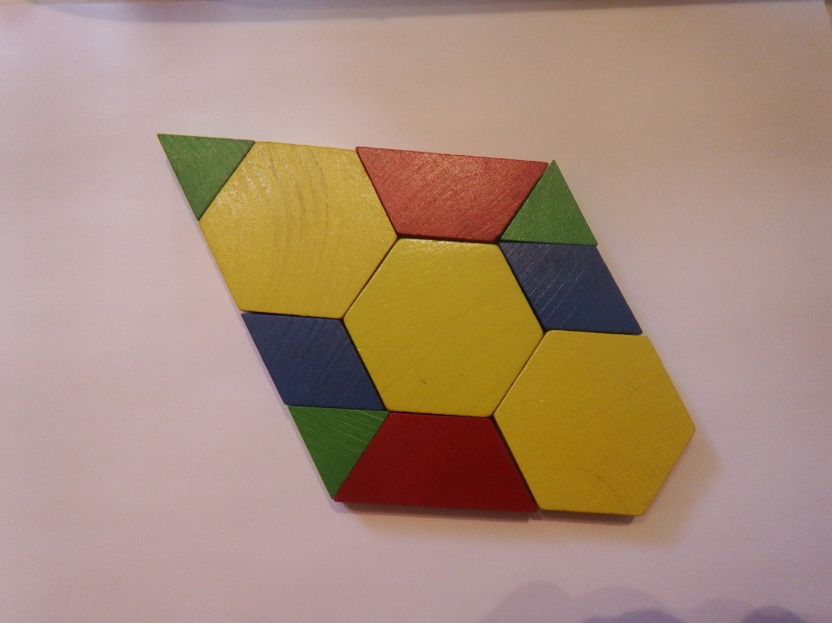
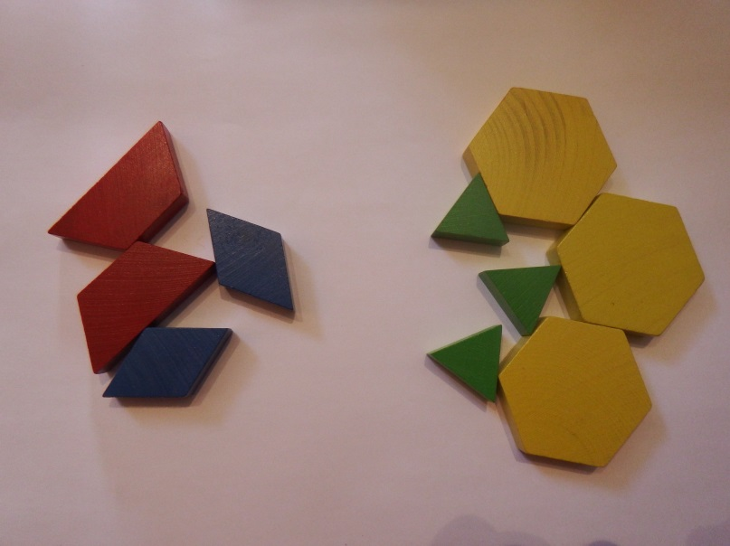
Part-Whole
Part-Whole
Part-Part
Part-Part
Notes:
Look at these 4 pictures.
In your group turn to your shoulder partner take a minute to think about this. Note that the same image is used to represent two different fractions. Can you justify this?
<<The top images represent Part-Whole and the bottom represent Part-part. They are using area model on the left and set model is on the right.>>
So you see how one model can be used across different constructs. That’s important because research tells us that in our instruction we tend to focus on the model rather than the construct. Sometimes the model may appear to ‘contradict’ the construct – when we see the pieces pushed together we assume area but the student may be thinking set. This is why we MUST ask students to explain and to annotate their thinking since our own bias influences our interpretation.

Slide 25
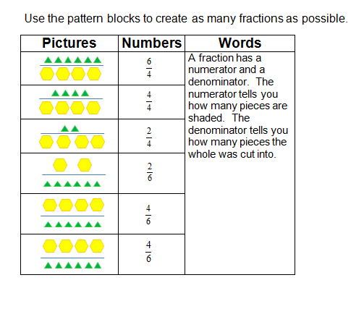
What do these students understand?
Notes:
This is a sample of student work (grade 6). The task was to illustrate fractions in many ways using a fixed set of pattern blocks. Two students choose to show them in pictures, numbers and words. The conflicting meaning between the words and the numbers and pictures illustrates how the student understanding is impeded by holding conflicting meanings. Lets look at this slide two columns at a time <Click> for next slide

Slide 26
Holding Conflicting Meanings Simultaneously
What do students understand?
Are some understandings
fragile?
Notes:
<<Click - A rectangle will block the word description column.>> When we see these remaining two columns together we believe that the student understands. Why? What else do you notice? (e.g. the students’ picture matches the fraction exactly numerator / denominator)
<<Click - the rectangle disappears.>>
<<Click - The rectangle now blocks the picture representation.>> If we looked at this, we might believe that the student understands fractions.
<<click - The rectangle disappears.>>
<<click – the questions appear.>> Talk at your table about these questions. What do the students understand? <<They understand the part-whole description of a fraction but have created part-part representations.>>
<<click – the title appears.>> Research across multiple mathematical concepts indicate that students can hold two conflicting notions at the same time and not see the conflict. What language do we teach students to help them describe part- part language?
<<Further notes re: Are some understandings fragile?
When the student described her work she described the left column as 6 triangles and 4 hexagons. When pressed further she described it as a group of 10…6 of which are triangles and 4 of which are hexagons. When asked to describe 6/4 in terms of her words column she explained it as being divided into 4 parts and having 6 of those 4 parts. It is a clear illustration of how she was holding two conflicting meanings at the same time. She couldn’t see that they were different meanings. She believed her words and pictures to be illustrating the same fraction.
Additional participant discussion may focus on:
Confusion may occur when presenting multiple constructs simultaneously.
Facilitator’s response can focus on: Punctuated lessons…best way to attack those who struggle with this idea “explore little and often” repetitive learning.. We often move fluidly between these constructs in real life – using part-part to make a mixture then describing the relationship using the part-whole construct. As teachers, we should focus on “surface(ing) the problematic situations that may arise and resolve them” rather than separate them by time and teach them separately. Confusion will and does exist even when constructs are not introduced simultaneously so it is not productive to ignore. By exposing students to various constructs we clarify thinking and use instructional moments to reinforce the importance of context.
2) Which answer is right or how right is she?
Facilitator’s response can focus on: the need to clarify the unit and the construct. The left hand side construct is part-part while the words illustrate part-whole. Both correct depending on context but cannot exist simultaneously. 6/4 can’t be illustrated by both the left pictorial and the right word description simultaneously. >>
The quote on the following slide reinforces the idea that looking at all or some constructs simultaneously is beneficial.

Slide 27
The Research is Clear
Mooseley’s 2005 research :
demonstrated that students who were familiar with both the part-part and part-whole interpretations had a deeper understanding of rational number
highlighted the need to expand students’ fractions understanding beyond the typical meaning that is focused on in mathematics programs in North America-fractions as part-whole relationships
Notes:
<<read the quote>>
This helps us when we move to the final activity.

Slide 28
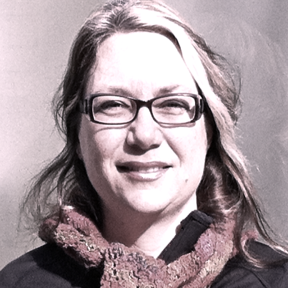





The Fractions Research Team 2011-2014
Curriculum and Assessment Policy Branch
TRENT MATHEMATICS EDUCATION RESEARCH COLLABORATIVE
DSBN
HWDSB
KPRDSB
OCDSB
SCDSB
SMCDSB
TLDSB
YCDSB
Cathy Bruce
Tara Flynn
Shelley Yearley
Rich McPherson
Sarah Bennett
Notes:
We have alluded to the research many times during this session. We are pleased to be here sharing the work that has resulted from a large network of participants and funding partners. This research is based in student thinking, grounded in international and national research, and field-tested in Ontario classrooms.
The research team has been engaged in collaborative action research (which means that a small group of classroom teachers [approx. 6 in our groups] meet with the research team for approx. 6 days over the course of several months; they use a pre-assessment to identify student needs and then co-plan next steps; the group observes students’ mathematical thinking by watching them in a class as they complete a task or watching a small group of students complete a task in an alternative site, such as the library; a post assessment allows the research team to correlate the activities to improvements in student understanding). This Ontario based research emerges from our local context.
The Collaborative Partners are Trent University, Government of Canada, and the Ministry of Education. That the Ontario Ministry of Education is involved in education research and supports is pretty unique within the broader international context. We are lucky to be working in Ontario.

Slide 29
Overarching Research Question
What instructional strategies support junior and intermediate grade students in the learning of fractions, an area of mathematics that is typically viewed as ‘difficult’ to learn?
Notes:
With the known research in mind, the overarching research question for the Ontario based research looks at: what instructional strategies support junior and intermediate grade students in the learning of fractions, an area of mathematics that is typically viewed as ‘difficult’ to learn?
Through the phases of the project, other questions are being pursued and are predominantly related to testing the hypothesized learning pathways. As the research progressed, primary and senior divisions were also explored.

Slide 30
Consolidation: Shape Sets Activity and Resources
www.edugains.ca
Notes:
We are now going to do an activity to consolidate our own understanding and can be used with students.

Slide 31
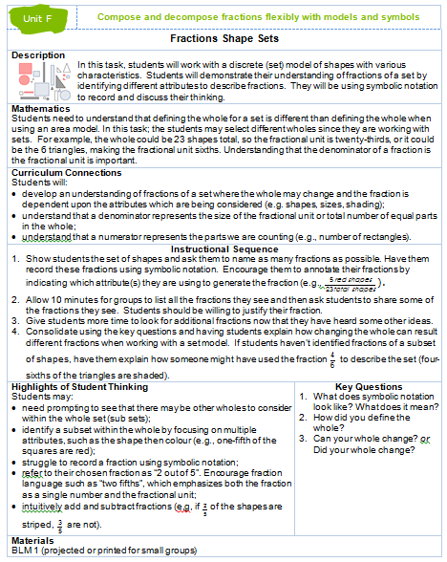
Fractions Shapes Sets
Using the shapes illustrated on the next slide create a fraction for each construct.
Justify your fraction to your shoulder partner.
Choose one to share with the larger group.
Notes:
Often students have understanding of the multiple constructs of fractions. This task will allow you to ascertain which constructs your students are familiar with. We will do it together now and if you wish to do it in your classroom afterwards, you can access it through Unit F of the Fractions Learning Pathways.
<<The inserted image is from Fractions Learning Pathways Task – as of Sept 12, 2014 refer to link in the Way we use Fractions Presentation Guide>>

Slide 32
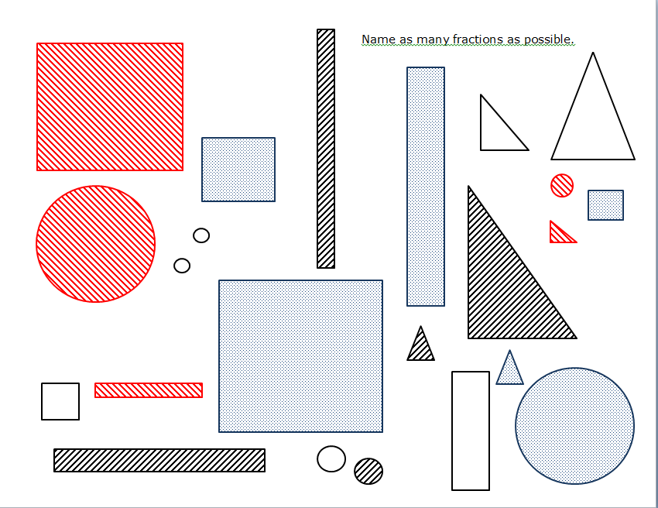
Name as Many Fractions as Possible
Notes:
<<Distribute one copy of the shapes per participant, http://www.edugains.ca/newsite/DigitalPapers/FractionsLearningPathway/UnitFractions-F-shapeSets.html>>
Work individually for some time and record several fractions. Then in your group guess how each others fractions might have been composed and share your thinking.
Are they part-part or part-whole?
<<Facilitators -Keep in mind that there are 23 shapes all together - we might reveal that after the activity but not before so that people can demonstrate flexibility in their thinking.>>

Slide 33
Implications Beyond Childhood
Adults continue to struggle with fractions concepts (Lipkus, Samsa, & Rimer, 2001; Reyna & Brainerd, 2007) even when fractions are important to daily
work-related tasks.
(Bruce & Ross, 2009)
Notes:
What are some work-related tasks you may encounter that might be related to part-whole, part-part, linear, quotient, operator?
<<This discussion will help to illustrate why increased understanding of fractions is important.>>

Slide 34
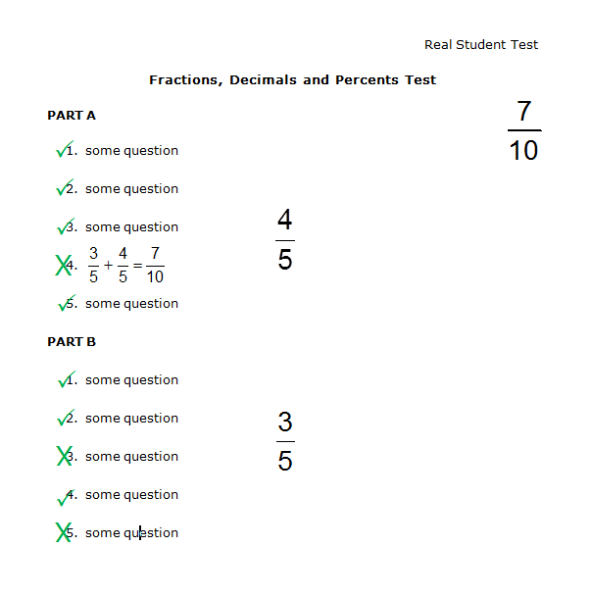
A “Real Life” Example
This is a recreation of an actual student test shared by Susan Ellis, Australia at OAME many years ago.
Notes:
This is a real example, noticed when a parent reflected on the results on a student’s quiz.
4 of the 5 questions correct in part A
3 of the 5 question correct in part B
For a total of 7 out of 10.
Look at the question the student got wrong.
This is a ‘real life’ illustration of how we simultaneously hold and use multiple constructs or meaning of fractions. We have lots of tacit knowledge that we don’t often unpack for students: We wrote the question thinking of part whole… but when we are marking we are thinking about ratios. We need to unpack this tacit knowledge and make it explicit so that students can make the same decisions that we make as they interact with fractions (Is this a part-whole construct or a part-part construct? What assumptions am I making about the mathematics?).

Slide 35
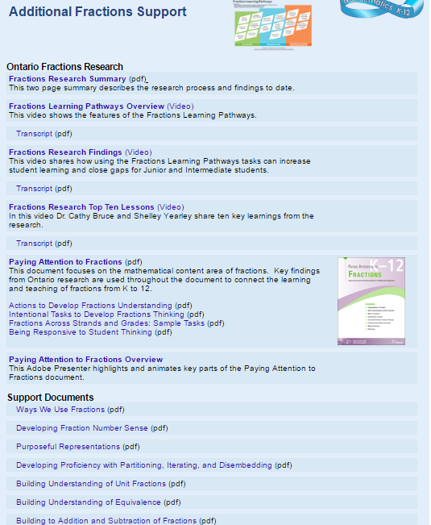
fractionsteaching.ca
Notes:
There are a number of fractions resources available for your use in the classroom and as professional learning tools. You can access the Fractions Learning Pathways here <click>. This outlines the concepts that students build as they progress in their fractions learning and includes tasks for use in classrooms.
You can download the Paying Attention to Fractions document and the four support pieces (which also include tasks for use in the classroom). There is also an Adobe Presenter <click> that provides an overview of the document and unpacks sections for further learning.
There are also two literature reviews (one on the foundations and one on multiplication and division of fractions) as well as document briefs <click> of key topics for improving teaching and learning of fractions.

Slide 36
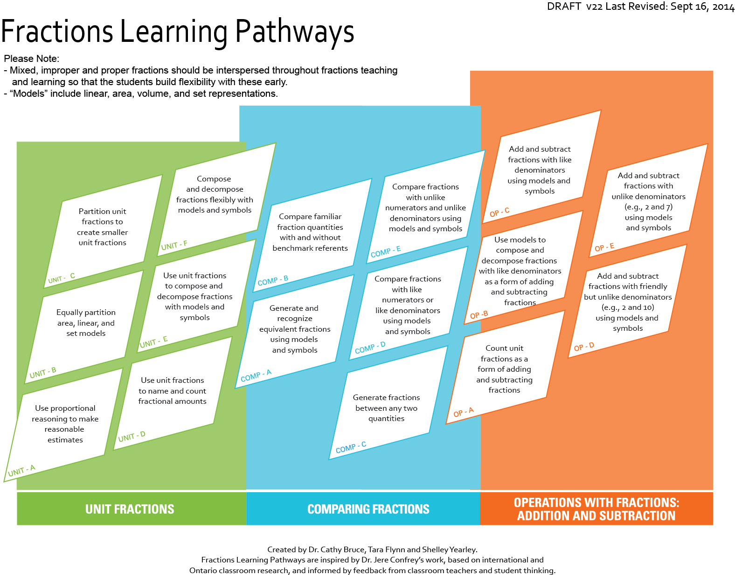
fractionslearningpathways.ca
Notes:
This is the Fractions Learning Pathways, which is an on-line, interactive resource. You can see that there are three clusters – unit fractions, comparing fractions and operations: addition and subtraction. Each cluster is comprised of cells which identify the knowledge and skills that research has demonstrated are required for successful fractions understanding. Clicking on a cell brings you to a landing page, which has a brief summary of the research on the left and links to tasks on the right. Clicking on a task allows you to access the task template (written by teachers involved in the research) which includes all task templates, an implementation video/photo (sometimes), student thinking samples and related research links. The Fractions Shapes Sets is located in Unit F. <<The sticky note activity is found in the digital paper resource section at fractionsteaching.ca : Pre-Pathway Fractions Research (Introduction to Representing Fractions)>>.
The research team is currently working on two more clusters on multiplication and division. Subscribe to an RSS feed on edugains.ca to ensure that you know when more information is added, including tasks currently in review.

